Slide 1
電腦視覺與深度學習 (Computer Vision and Deep Learning) Homework 2
TA:
Lydia: lydia2200284@gmail.com
Office Hour: 17:00~19:00, Mon.
10:00~12:00, Wed.
At CSIE 9F Robotics Lab.

Slide 2
Notices (1/2)
Copying homework is strictly prohibited!! Penalty: Grade will be zero for both persons!!
If the code can’t run, you can come to our Lab within one week and show that your programming can work. Otherwise you will get zero!!
Due date => Midnight 23:59:59 on 2020/12/30 (Wed.)
No delay. If you submit homework after deadline, you will get 0.
Upload to => 140.116.154.1 -> Upload/Homework/Hw2
User ID: cvdl2020 Password: cvdl2020
Format
Filename: Hw2_StudentID_Name_Version.rar
Ex: Hw2_F71234567_林小明_V1.rar
If you want to update your file, you should update your version to be V2, ex: Hw2_F71234567_林小明_V2.rar
Content: project folder*( including the pictures ) *note: remove your “Debug” folder to reduce file size

Slide 3
Notices (2/2)
Python
Python 3.7 (https://www.python.org/downloads/)
opencv-contrib-python (3.4.2.17)
Matplotlib 3.1.1
UI framework: pyqt5 (5.15.1)
C++ (check MFC guide in ftp)
OpenCV 3.3.1 (https://opencv.org/release.html)
Visual Studio 2015 (download from http://www.cc.ncku.edu.tw/download/)
UI framework: MFC

Slide 4
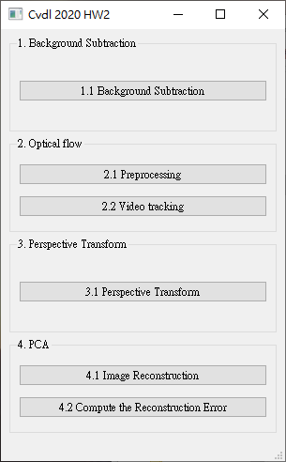
Grading
1. (20%) Background Subtraction (出題：Brian)
2. (20%) Optical Flow (出題：Kevin) 2.1 Preprocessing (10%)
2.2 Video tracking (10%)
3. (20%) Perspective Transform (出題：Max)
4. (20%) PCA (出題：Mark)
4.1 Image Reconstruction (10%)
4.2 Compute the reconstruction error (10%)
5. (20%) Dogs and Cats classification Using ResNet50 (出題：Bill)
UI example

Slide 5
2. (20%) Optical Flow (出題：Kevin)
2.1 Preprocessing (10%)
2.2 Video tracking (10%)

Slide 6

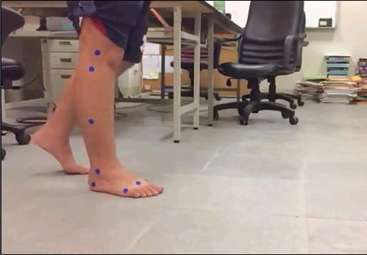
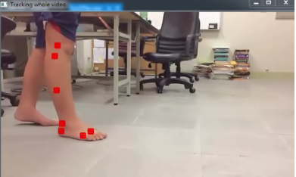
2.1 Preprocessing (10%) (出題：Kevin)
Given a video: opticalFlow.mp4
Q: Click the button to show the square boundary with red cross mark (not red filled like the ex. image).
window size: 11
Center point
Ex:
7 blue circles
(0,0)
x
y

Slide 7
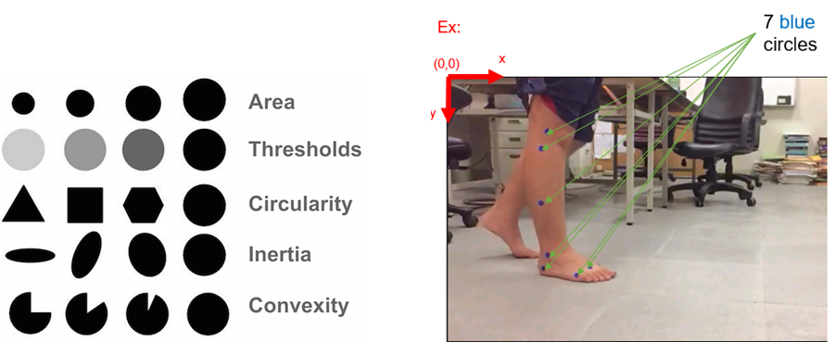
How to detect 7 center points of 7 blue circles
You can use cv2.SimpleBlobDetector() to detect blobs (binary large object), it can filter out blobs by examining their:
Area (size)
Thresholds (gray level)
Circularity (if perfect circle, then it is 1.0)
Inertia (ratio of the minor and major axes )
Convexity (if no gap, then it is 1.0)

Slide 8

2.2 Video tracking (10%) (出題：Kevin)
Q: Click button to:
(5%) Track the 7 center points on the whole video using OpenCv function cv2.calcOpticalFlowPyrLK. Ex: https://github.com/opencv/opencv/blob/master/samples/cpp/lkdemo.cpp
(5%) Connect 7 corresponding tracking points of all frames (the whole video) to get 7 trajectories (flow). Ex: the demo video.
Demo video:
Tool site:
Load video
Circle detect
Optical flow
※ Tracking process may be fail, you should make the result as good as possible (at least 4~5 points success)

